Slide 1
Virtualization
Prof Yotov
CS 6233
Based on https://gcallah.github.io/OperatingSystems/index.html By Prof Callahan

Slide 2
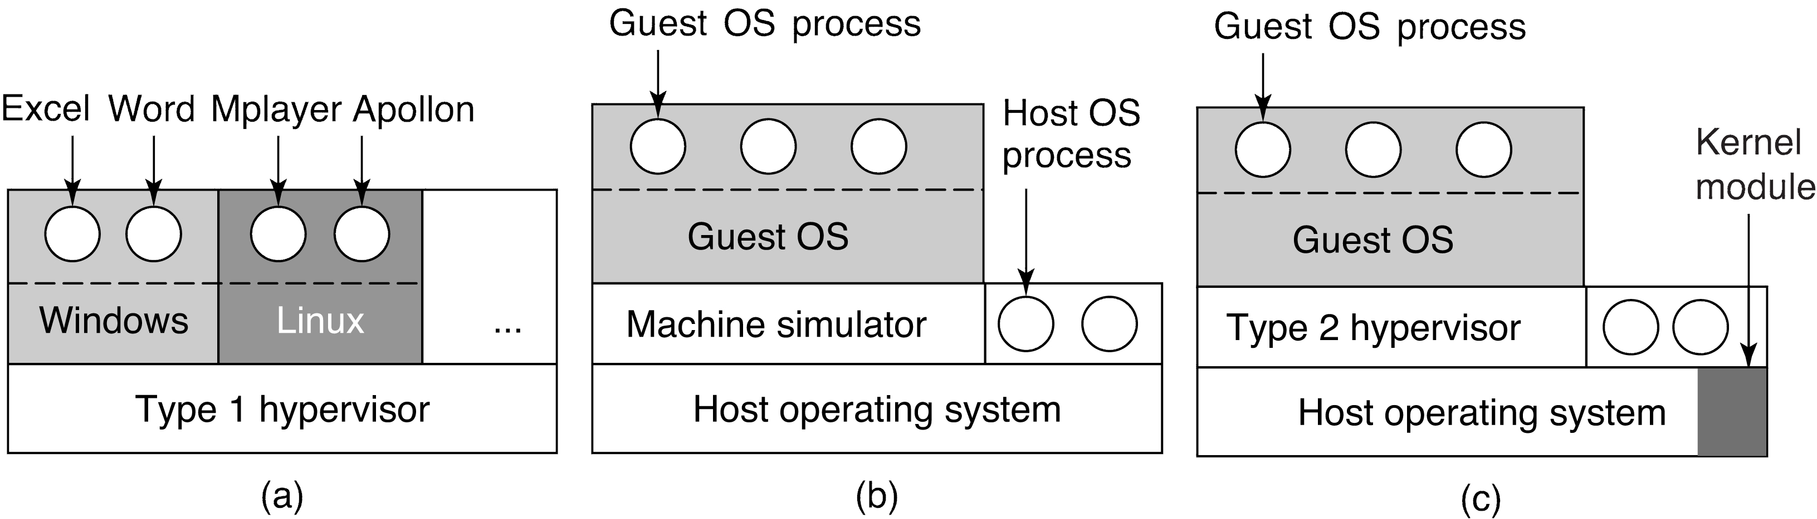
History

Slide 3
History
IBM was developing hypervisors in the 1960s. SIMMON and CP-40
The formal requirements for virtualization were laid out in a 1974 paper (Popek and Goldberg).
In the 1990s, VMware was created, offering type 1 and type 2 hypervisors.
Other products: Xen, KVM, VirtualBox, Hyper-V, Parallels.
Timeline

Slide 4
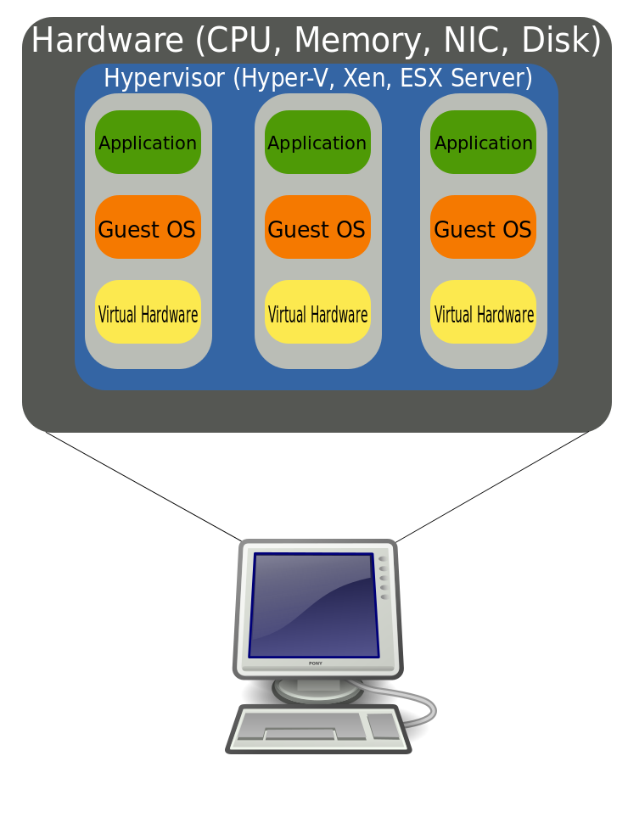
Requirements
Hypervisors need to score well on
Safety: the hypervisor has full control of the virtualized resources.
Fidelity: the behavior of a program running on the virtual machine should be the same as if it were running on the machine being imitated.
Efficiency: as much code as possible should run without intervention by the hypervisor.

Slide 5
Requirements (cont.)
An interpreter can be safe and faithful, but performance will be bad.
Sensitive instructions: behave differently if executed in kernel mode than when executed in user mode.
Privileged instructions: trap if executed in user mode. Popek and Goldberg showed that a machine is virtualizable only if the sensitive instructions are a subset of the privileged instructions. The Intel family did not have this property until 2005. Also, user mode programs could read senstive info, like whether they were in user mode. (We don't want the guest OS doing this.) What we need is trap-and-emulate.
So how were hypervisors possible before 2005?! Answer: binary translation.
Another approach: paravirtualization. Here, the host presents a "machine-like" software interface that allows the guest to make hypercalls. Drawback: the guest has to be aware it is running on a VM, since it has to make the hypercalls.

Slide 6
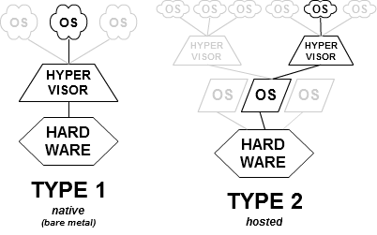
Type 1 and Type 2 Hypervisors

Slide 7
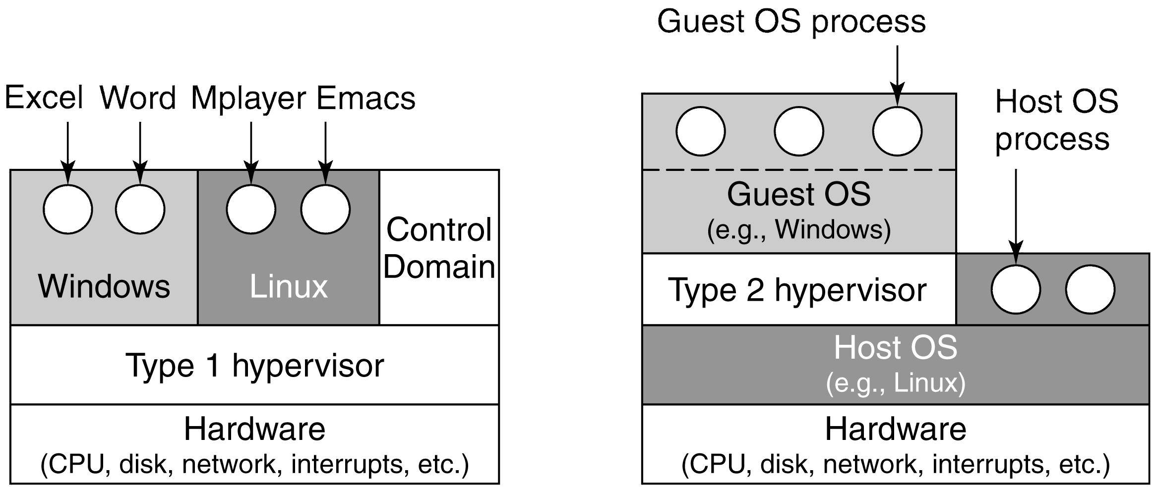
Type 1 vs. Type 2 Hypervisor

Slide 8
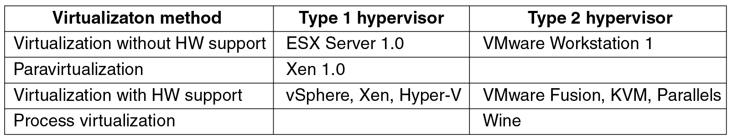
Type 1 vs. Type 2 Hypervisor

Slide 9
Type 1 vs. Type 2 Hypervisor
Type 1
Runs directly on the hardware. This makes it essentially an OS.
https://youtu.be/szhEiTOUt2s
Type 2 This is a program that runs in an underlying OS. For example, Parallels runs on MacOS, and allows Windows or Linux to run on it. Also called hosted hypervisors. It installs a guest OS by pretending it is a machine being booted for the first time, and installing the OS from media, onto a "disk" (that is really an ordinary OS file).
https://youtu.be/xTkvClJZmyA

Slide 10
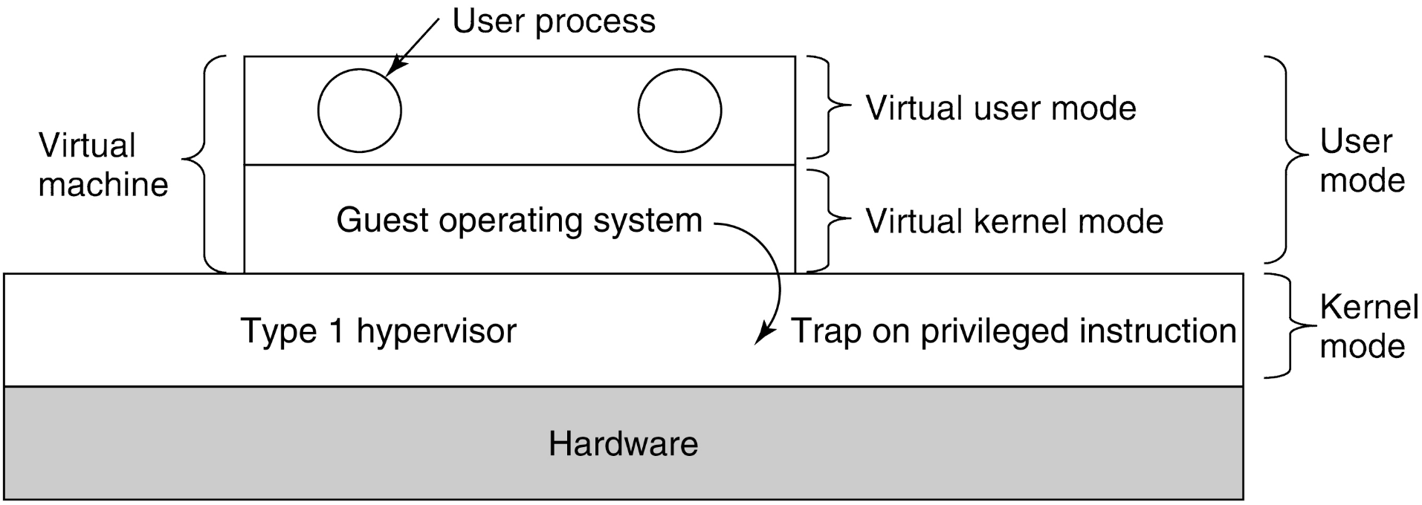
Techniques for Efficient Virtualization
Scenario: a type 1 hypervisor is running a guest OS that thinks it is the kernel, but really is in user mode. The guest runs in virtual kernel mode. Its apps think they are in user mode (and really are). What happens when the guest executes a privileged instruction? Normally, this would cause the program to crash. But with VT, the instruction traps to the hypervisor, and the hypervisor determines if the guest OS (or at least its kernel) called it -- OK! -- or a guest application did -- not OK!

Slide 11
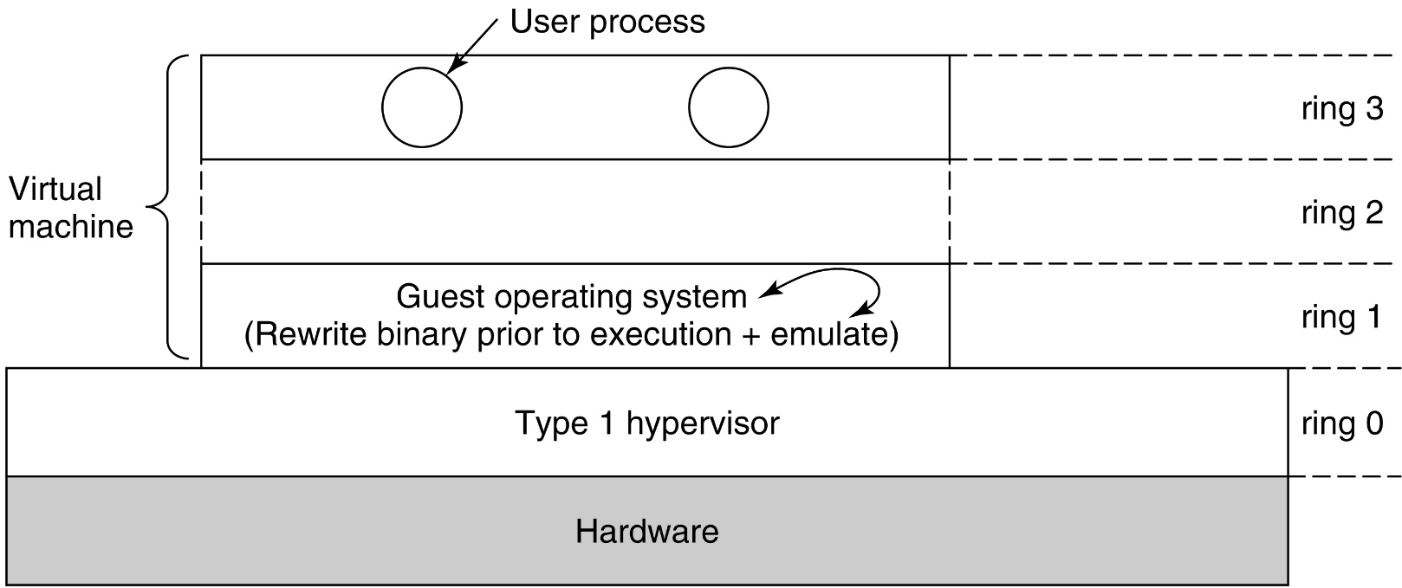
Techniques for Efficient Virtualization Virtualizing the Unvirtualizable (Type 1)
So how was this handled before VT was available?
Using techniques like binary translation and protection rings.
Sensitive instructions are eliminated by re-writing the guest's kernel code, one basic block at a time. A basic block is a run of consecutive instructions, where the instruction pointer advances a single instruction at a time. Sensitive instructions are replaced with calls to hypervisor procedures.
Translated blocks are cached, so that they do not need to be translated again.

Slide 12
Techniques for Efficient Virtualization Virtualizing the Unvirtualizable (Type 2)
Type II hypervisors are little bit different, in that they rely upon the host's device drivers. They are like teenagers hosting a party while their parents are away: they can move everything, so long as it is all back in place when the parents return. This restoration is called a world switch.

Slide 13
Techniques for Efficient Virtualization (The Cost of Virtualization)
Do CPUs with VT outperform software-based approaches?
Not necessarily! VT generates lots of traps, and traps are expensive.
Sometimes software beats hardware
so sometimes hypervisors translate anyway, even if there is hardware support.
An example where translation is cheaper
Turning off interrupts may be very expensive, if there are deep caches and out-of-order execution.
But a hypervisor need not really turn off interrupts: it only needs to make it look to the guest OS as if they are off. So it can just keep a binary flag per guest OS: much cheaper!

Slide 14
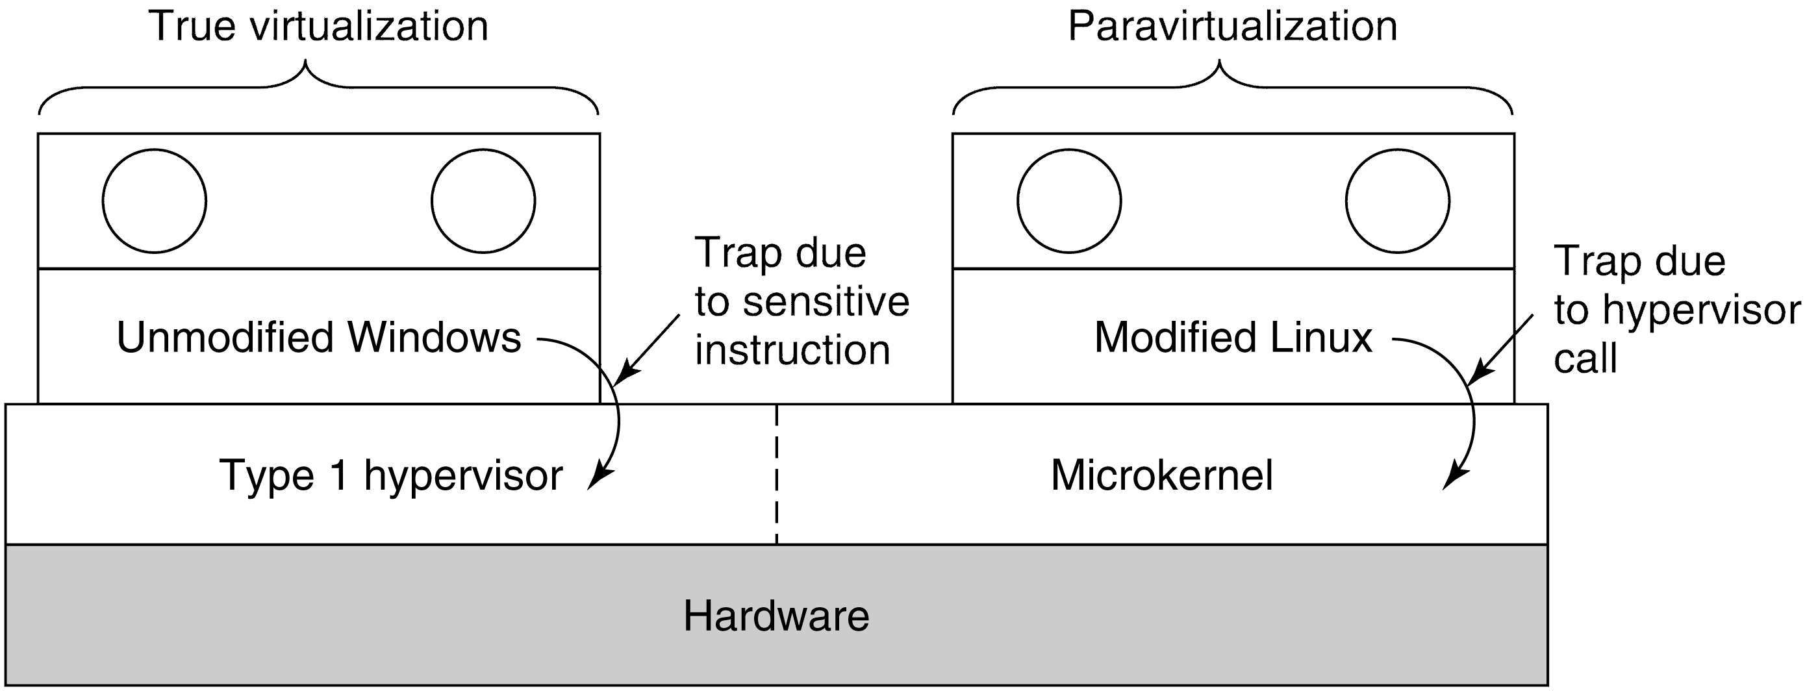
Are Hypervisors Microkernels Done Right?
With paravirtualization, the hypervisor in effect acts like a microkernel, and the guest OSs are like modules running on top of it.
They make hypercalls into the hypervisor, instead of the hypervisor trying to emulate difficult hardware instructions.
Of course, this means the guest OS knows it is a guest and a special version of it must be run.

Slide 15
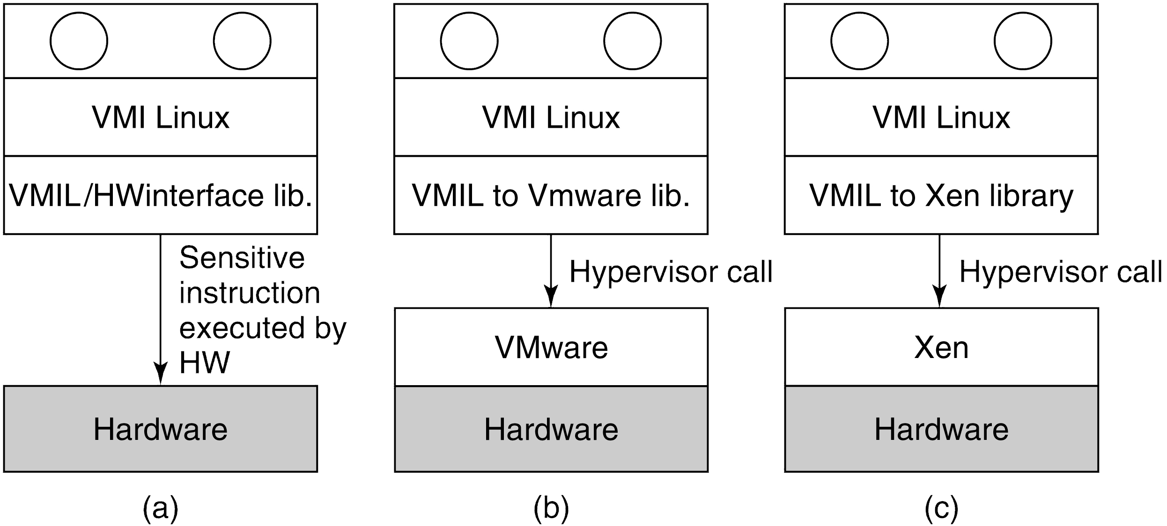
Issues with Paravirtualization

Slide 16
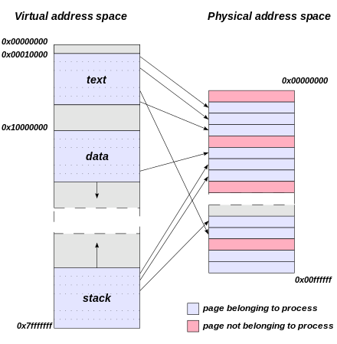
Memory Virtualization

Slide 17
Memory Virtualization Shadow Page Tables
The problem is that each guest OS thinks it is "president of the university," and can map virtual pages to real pages as it wishes to.
But it isn't president: the hypervisor is. And some other guest OS may be using those physical pages already.
Solution: a shadow page table.
The hypervisor traps on the sensitive instruction that loads a hardware register to point to the page tables. (On a type 1 hypervisor with VT.) It maps the guest OS virtual pages to their real hardware addresses.
But the hypervisor will need to update the shadow page table every time the guest OS page tables update. How? The guest OS just writes to memory to update these: no sensitive instruction is used.

Slide 18
Memory Virtualization Page Faults
Two possible ways to handle this: 1) Make the guest OS page tables read-only, so any attempt to access them creates a page fault. 2) Let the guest OS modify its page tables at will: then attempts to access those pages will create page faults.
Both methods will create lots of... page faults! And page faults are expensive.
We distinguish two types of page faults: 1) guest-induced page faults, which involve pages actually swapped out of RAM; and 2) hypervisor-induced page faults, which occur in order to keep the shadow page table up to date.
Page faults are extra expensive in virtualized environments, because they lead to VM exits.
In a VM exit, the hypervisor regains control. This involves saving and restoring lots of state, and may tens of thousands of cycles.
With paravirtualization, the situation is different. The guest OS knows it is virtualized, and knows to notify the hypervisor when its page tables have been updated.

Slide 19
Memory Virtualization HW Support for Nested Page Tables
There is now hardware support for nested page tables (AMD) or Extended Page Tables (Intel).
With virtual memory, the OS is already mapping between virtual pages and physical pages. Nested page tables simply extend that scheme so that we can have several layers of mapping.
We now have guest virtual addresses, guest physical addresses, and host physical addresses.
No need to maintain shadow page tables.
No need for VM exits.
Switching virtual machines changes the mapping the same way an OS does when switching processes.

Slide 20
Memory Virtualization Reclaiming Memory
The hypervisor may need to reclaim memory at times. Why?
Overcommitment is the allocation of more virtual memory to VMs than there is actual physical memory, e.g., on a 32GB machine, running three 16GB VMs.
Deduplication is when certain pages are shared between VMs, e.g., the Linux kernel.
The hypervisor can't really page out guest pages, because it has no clue which ones should be kept in memory.

Slide 21
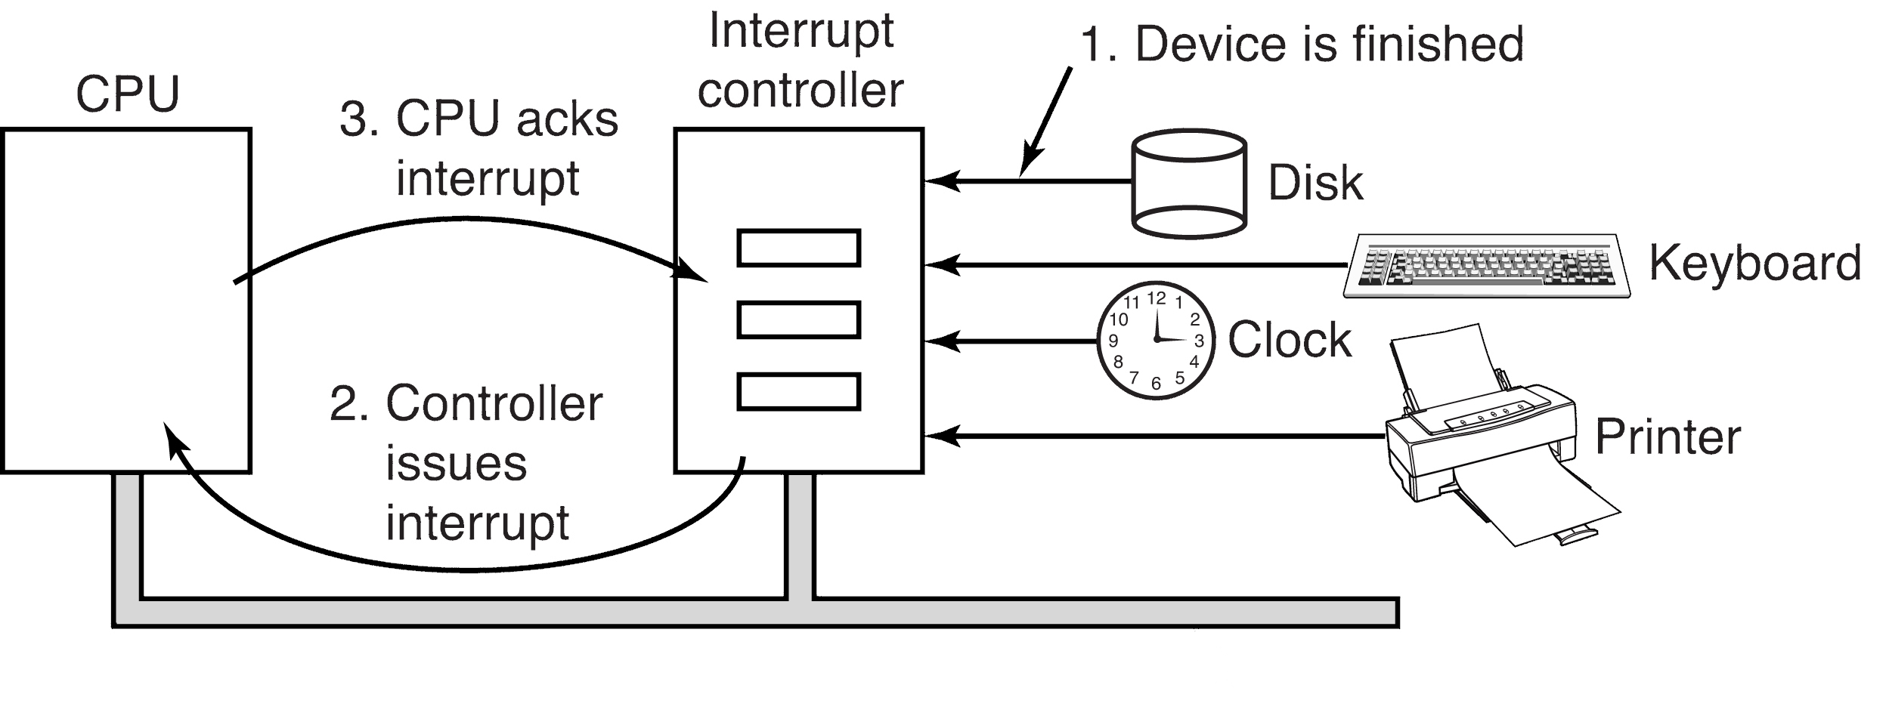
I/O Virtualization

Slide 22
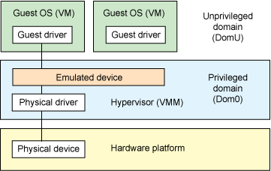
I/O Virtualization
The guest OS will begin by probing for hardware devices.
What should the hypervisor do?
One approach: respond with a list of the actual hardware devices.
Guest OS attempts to write to the device registers will then trap (they are sensitive instructions), and the hypervisor can then do whatever is needed, perhaps just really write to those registers.
But the hypervisor can also "fake" devices: pretend to have an old device when a fancy new one has been installed. This allows device upgrades to be invisible to the guests.
https://youtu.be/EfcG852_W6w

Slide 23
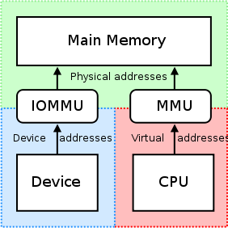
I/O Virtualization I/O MMUs
The problem: DMA. DMA hardware is trying to directly access memory. This memory must be re-mapped for VMs.
I/O MMU (memory management unit): virtualizes I/O the same way an MMU virtualizes memory.
The I/O MMU eliminates the DMA problem. It maps device memory addresses to real physical addresses. It can keep different guests DMA out of each other's way.

Slide 24
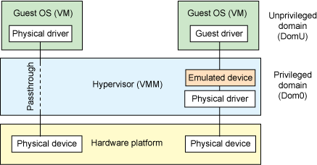
I/O Virtualization I/O MMUs
Device pass through allows both the device and the guest OS to be unaware that any address translation may be going on: both think they are directly addressing the same memory locations. It is useful when sharing a device between VMs is not feasible.
Device isolation lets a device assigned to a VM directly access its memory without interfering with other guests.
Interrupt remapping is necessary so that the right interrupt goes to the right VM. A generated interrupt hits the I/O MMU first, which redirects it to the proper VM with the proper interrupt vector.

Slide 25
I/O Virtualization Device Domains
In this approach, one VM runs a standard OS, and all I/O calls from other VMs are directed to it.
Type 2 hypervisors have an edge here: the OS upon which they run can have device drivers for all sorts of unusual I/O devices (3D printers, virtual reality setups, smell-o-ramas, etc.)
The authors contend that as VM matures, hardware enhancements will allow guest OSs to access hardware devices directly in a secure way.

Slide 26
I/O Virtualization Single Root I/O Virtualization
We often can't directly assign a device to a VM. What if we have 128 VMs on a server... we would need 128 network cards to directly assign a VM to each!
We can do this in software, but we may not be able to take advantage of all of a device's advanced features, because the software has no support for them. (The tendency will be to support the common features among various devices first.)
PCIe provides a solution in hardware. It is known as Single Root I/O Virtualization (SR-IOV), by allowing SR-IOV devices to provide an independent memory space, independent interrupts, and DMA streams to each VM.
PF (Physical Function): These allow the administrator to configure the device directly, however they see fit.
VF (Virtual Function): These provide lightweight functions that trick a VM into thinking it is sole owner of some device. Some device hardware supports this: Intel I350 network cards have 8 separate send and receive queues, which provides hardware support for up to 8 VMs that think this is their own card.
https://youtu.be/zCsYA81b2xI

Slide 27
Virtual Appliances
These are a solution to how to install applications dependent on a host of factors, such as language libraries, database instances, environment variables and configurations, operating system versions, and so on.
Software as a Service: Amazon Web Services "SaaS has become a common delivery model for many business applications, including office and messaging software, payroll processing software, DBMS software, management software, CAD software, development software, gamification, virtualization, accounting, collaboration, customer relationship management (CRM), management information systems (MIS), enterprise resource planning (ERP), invoicing, human resource management (HRM), talent acquisition, content management (CM), and service desk management. SaaS has been incorporated into the strategy of nearly all leading enterprise software companies." Wikipedia
https://youtu.be/-oF-lM5PWLY

Slide 28
Clouds
On-demand self-service: users do not need human help to add service.
Broad network access: resources are available over the network via standard mechanisms (e.g., http).
Resource pooling: users acquire resources from a common pool, and have no idea where "their" resources live.
Rapid elasticity: fast an automatic scaling has loads change.
Measured service: the services are metered much like electricity usage.

Slide 29
Clouds as a Service
Infrastructure as a service (IAAS): Offers direct access to a VM user can use as they see fit.
Platform as a service (PAAS): Includes things such as web servers and databases.
Old worries gone: backup, power, cooling, scalability, upgrading, etc.
New worries arrive: is data secure? What laws apply? Can a co-hosted competitor snoop?
Vendor lock-in: once you choose a cloud provider, can you ever (practically) leave?
https://youtu.be/vgI5F5Si518

Slide 30
Clouds: Virtual Machine Migration
How to migrate to faster hardware, off of broken hardware, etc.?
We could shut down all virtual machines and re-start them on new hardware: significant pause!
We could pause them, transfer their memory, and resume: still a noticable pause.
Or, using pre-copy memory migration, we can copy pages first, then do a live migration. If no one notices, it was a seamless live migration!
https://youtu.be/gFKGgoHDRi8

Slide 31
Clouds: Checkpointing
Captures the machine at various times, so we can rollback if we need to.
Use copy on write to save time: only copy what has changed.
Unsolvable: what to do about remote machines that were interacting with ours? A: Nothing can be done (in general).

Slide 32
Case Study: VMWare

Slide 33
Early History
Based on work at Stanford in the late 1990s.
The founders realized that rather than solving existing problems in large, complex, operating systems, one could innovate in a layer below the OS.
1998:
VMware Workstation for Linux Ran on top of Linux.
VMware Workstation for Windows Ran on top of Windows.
2001: ESX Server
Aimed at the server consolidation market.
Prior practice: buy a server for each email, web, DB server application.
Machines were often at 10% capacity!
2002: Virtual Center / vSphere: Manage 1000s of virtual machines from one application.
VMotion: Live migrate servers. https://youtu.be/9f5GFB0m_E4

Slide 34
VMWare Workstation
The first virtualization product for 32-bit x86.
The "WinTel" platform was very different from vertically integrated mainframes:
Intel and AMD build the chips.
Microsoft (Windows) and open source (Linux) provide the OS.
A third group of companies build peripherals.
A fourth group of integrators (Dell, HP) build systems for retail sale.
What's more, there was no hardware support for virtualization.
So VMware had to use existing techniques of virtualization, borrow techniques from other areas, and invent some.
https://youtu.be/_GVZHuHHdnk

Slide 35
Goals and Requirements
Hypervisors add a level of indirection to the domain of computer hardware. They provide the abstraction of a virtual machine: each one thinks if is "king of the hill," and has a whole machine to itself. Ideally, the VMs should be just like the emulated machine, as fast as the emulated machine, and completely isolated from each other.
VMware had these goals (general to most virtualization):
Compatibility: Any x86 OS, and all of its applications, should be able to run on without modifications on the VM.
Performance: The overhead of the hypervisor had to be low enough the users could use a VM as their primary machine. Ideally, things run as fast as on a native OS, but at least as fast as the previous chip generation.
Isolation: The hypervisor had to ensure complete isolation of each VM, i.e., be completely in charge of the real physical resources. A VM might be infected with malicious code: this will not impact any other VM.
There was tension between the requirements. E.g., total compatibility might need to be sacrificed for performance. But the designers held isolation as paramount.

Slide 36
Challenges
The x86 architecture did not support virtualization. ( Popek and Goldberg requirements for virtualization ) Example: POPF (pop flags) would fail silently in user mode.
The x86 architecture was of daunting complexity. Decades of "cruft" built up due to backwards compatibility goal. Four modes: real, protected, v8086, and system management. x86 operating modes.
x86 machines had diverse peripherals.
The need for a simple user experience. The users would be doing the installs themselves, not (e.g.) an IBM technician.

Slide 37
Solutions: Virtualizing the x86 Architecture
VMM (Virtual Machine Monitor): runs the actual virtual machine.
VMX: interacts with host OS.
Possible approaches:
Rely on hardware support for virtualization to trap-and-emulte privileged instructions. Not available on x86 until 2005. Trap
Dynamic binary translation: the VMM emulates all instructions. Problem: too slow for most uses. (5x)
https://youtu.be/CLR0pq9dy4g

Slide 38
Solutions: Virtualizing the x86 Architecture (cont.)
The solution:
Trap-and-emulate can be used when user programs are running.
In other cases, resort to binary translation.
Run an algorithm to decide which to do. This doesn't need to examine code, just registers!
Binary translation must be used if:
The virtual machine is running in kernel mode (ring 0).
The virtual machine can disable interrupts and issue I/O instructions.
The virtual machine is running in real mode, a legacy 16-bit mode used by BIOS.
VMware can speed up binary translation to near-native speeds because it sets the hardware to run the code instead of translating it in software.
Runs at 80% of native speed, instead of 20%.

Slide 39
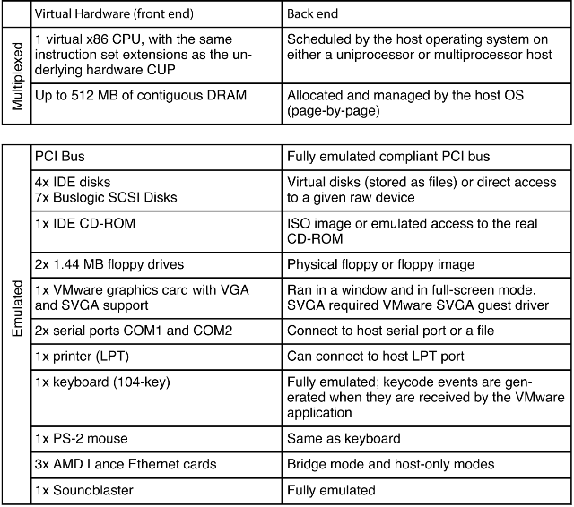
Solutions: A Guest OS Centric Strategy
Two layers:
Software model that "looks like" the device to the guest OS.
A back-end that communicates with the host OS.
Example: the "Lance" 10-Mbps ethernet card. VMware "supported" this card long after the real thing was off the market, and eventually could run 10x faster. The actual hardware did not have to be what the guest OS thought was there! It just talked to the VMware drivers, and they could be coupled with different back-ends.

Slide 40
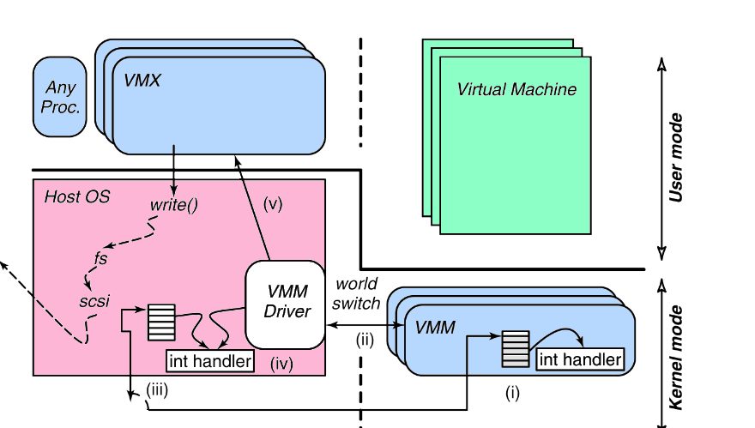
Solutions: The Role of the Host OS
By creating a type 2 hypervisor, VMware could be installed like a normal program.
It could use the host's drivers to handle the problem of multiple peripherals.
But VMware needed to do fancy things an ordinary application could not.
And many of those things an ordinary kernel-level device driver shouldn't do either.
So, create three components:
VMX: a user-space program the user interacts with: one per VM.
VMX driver: A small kernel-mode device driver that can suspend the host OS for the...
VMM: multiplexes the CPU and memory; contains trap-and-emulate, device drivers, shadow paging module, binary translator. Runs in kernel mode, but not "in" the host OS.

Slide 41
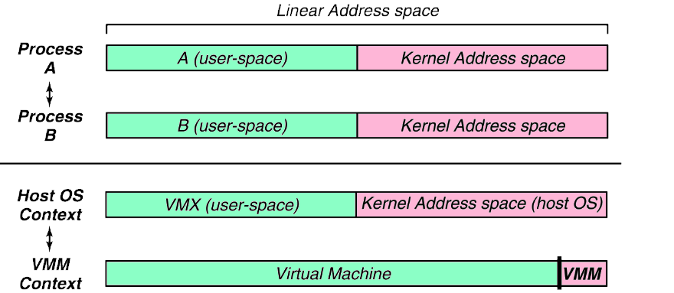
Solutions: The Role of the Host OS (cont.)
VMX runs as an OS process. But the VMM is a peer. The VMX suspends the host OS and gives the VMM full control of the machine. This is a world switch.
The VMM and the host OS have entirely different address spaces.
Although earlier described as very time consuming, here the book says the world switch only takes 45 instructions!

Slide 42
Evolution of VMWare Workstation
The VMM / hhost OS architecture remains the same. But today, VMware Workstation can rely on:
Trap-and-emulate all the time
Nested hardware page tables instead of the shadow page table
https://youtu.be/lD_y5wTjRqs

Slide 43
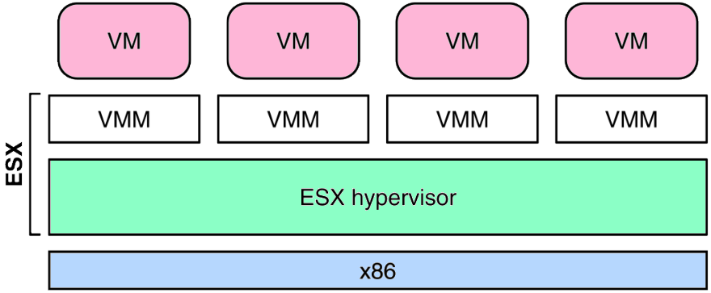
ESX Server: VMware’s Type 1 Hypervisor
Not having a host OS to rely upon means ESX has more work to do than VMware Workstation. But in a situation where IT organizations are trying to run 1000s of virtual machines, a type 1 hypervisor makes sense: it will run significantly faster.
The CPU scheduler ensures that each virtual machine gets a fair share of the CPU: no starvation.
Scalability: VMs run efficiently even when they need more memory than is actually available. Ballooning and transparent page sharing introduced.
An optimized I/O subsystem: device drivers run directly within the ESX hypervisor, with no world switch required.
ESX uses a file system (VMFS) optimized to store virtual machine images. A single ESX Server can issue over 1 million disk operations per second.
The workstations were aimed at developers: one could experiment with new OS releases inside a VM.
ESX Server made it easy to implement new capabilities.
VMotion: live migrate a VM from one box running ESX Server to another. This required the coordination of the memory manager, the CPU scheduler, and the networking stack.
https://youtu.be/Hm7kQHI4YnM

